Slide 1
LIBER Annual Conference 2016
Libraries Opening Paths to Knowledge
Defining National Solutions for Managing Book Collections and Improving Digital Access
Neil Grindley, Head of Resource Discovery, Jisc
Paola Marchionni, Head of Digital Resources for Teaching, Learning and Research, Jisc

Slide 2
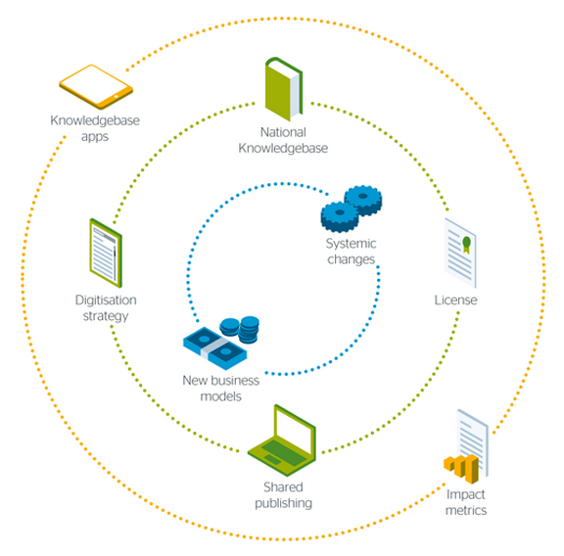
The National Monograph Strategy
2012 - 2014
The Vision
Within 5 years UK researchers and students will have unparalleled access to a distributed national research collection enabled by an open collaborative national infrastructure

Slide 3
Research Focused Universities
Issues of concern to UK academic libraries
Teaching & Business Engaged Universities
Specialist Colleges & Research Institutions

Slide 4
Management of print collections (space management)
Collection management (benchmarking and development)
Collaboration to reduce duplication (data, cataloguing effort, resource investment)
Poor data quality
Disambiguation and de-duplication of metadata records
Discovery of digital surrogates
The procurement, management and discovery of e-books
Metadata standards and persistent identifiers
Licensing, rights and permissions for access
National and international authority sources
National coverage
Building sustainable and effective platforms
International engagement
Data formats and emerging opportunities for exploiting data
Preservation and conservation
Consuming the data and the end user perspective
(source: Jisc Bibliographic Data Roadmap Group: September 2014 - January 2015)

Slide 5
What problems are we trying to solve?
Libraries want to make data-driven decisions about the management of their print and digital book collections but the data that is currently available does not allow them to do this with confidence
Libraries want to ensure that researchers and learners have sustainable and convenient access to digital books but it is currently not obvious what is available or what could readily be made available

Slide 6
Principles …
The UK has a fundamental need for a new national-scale service to drive a range of required functions
The new service should consist of an aggregated database and its management should be outsourced to an organisation that is capable of delivering the service as core business at scale
The primary focus of future effort should be on supporting UK academic libraries with collections management. Resource discovery and records delivery are of secondary importance
https://monographs.jiscinvolve.org/wp/files/2015/11/BiblioData_NMS_Next_Steps.pdf

Slide 7
Principles …
The data contributed to the new system must remain sharable and reusable by all contributing organisations and by other relevant organisations that support discovery and records delivery
The route to greater impact for contributed library data is through exposure to global search engines and other high impact web-scale channels rather than through reliance on Jisc-funded discovery interfaces
The new system should combine knowledge about both print and digital publications for services to be efficient and effective
https://monographs.jiscinvolve.org/wp/files/2015/11/BiblioData_NMS_Next_Steps.pdf

Slide 8
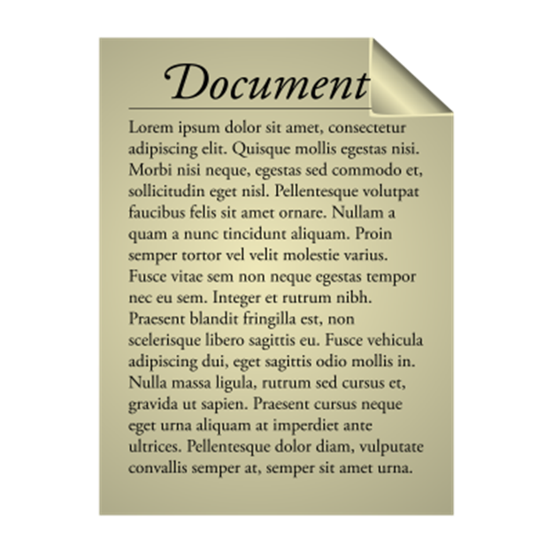
The National Bibliographic Knowledgebase (NBK)
Bibliographic Data
Supported Functions
Availability Data
Legal Deposit Libraries
Benchmarking Collections
Academic Research Libraries
Managing Print Collections
Identifiers
Document Delivery
Teaching & Business Engaged Libraries
Digitisation and Preservation
Specialist Libraries
Standards
Resource Discovery
Open Access Book Directories
Copy Cataloguing
Usage Data

Slide 9
From a library
From a publisher
From the Web
From a repository
Availability Data
Identifiers
Standards
Usage Data
The National Bibliographic Knowledgebase (NBK)
Circulation data
Usage data
Demand information

Slide 10
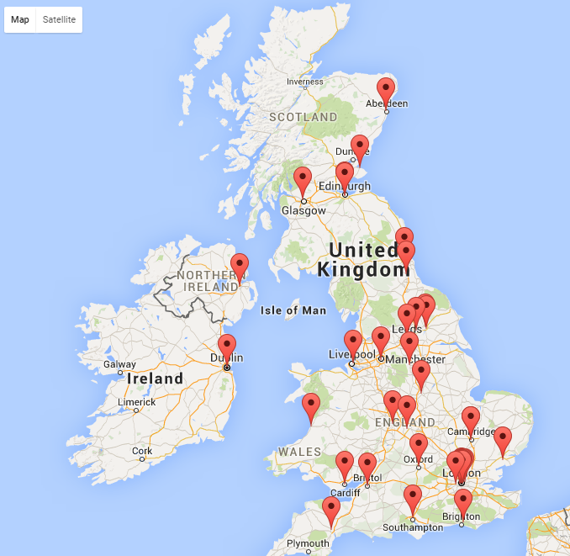
Tools & services layer
Support services
Collection Management
Community Engagement
Data Sharing
Identifiers
Advice & guidance
Metadata Linking & Research
Standards
Version tracking & linking
Data quality enhancement
Support for new publishing models
The National Bibliographic Knowledgebase

Slide 11
Identifiers
Standards
The National Bibliographic Knowledgebase

Slide 12
NMS report recommendations:
Rec #5:
Digitisation strategy
Building a national digital research collection
Rec #6:
Licencing strategy
A nationally negotiated agreement for digital monographs
Two sides of the same coin:
Ambition to increase access to digital monographs as part of a national digital collection
Of benefit to collections managers to enable more informed collections management decisions
Based on evidence of need
Notes:
Both recs have in common the ambition to increase access to digital monographs as part of a national digital research collection for the benefit of researchers and students but also for the benefit of collections managers, to enable them to make more informed collections management decisions.
The other common aim was to ensure that a strategic approach to increasing access was evidence-based, ie founded on analysis of needs and demand from institutions and their researchers and students.
It soon became apparent that these two recs were the two sides of the same coin and needed to be explored in a holistic way.
NMS #5 Digitisation: A national strategy informed by and developed in conjunction with the monograph knowledgebase, that: Has a national collection management approach (providing access to, and preserving the national collection)
Undertakes analysis and prioritises collections for digitisation; Defines and helps enable digitisation infrastructure/services; Sources and secures funding
NMS #6: A nationally negotiated agreement for digital monographs.
A license negotiated by a third party on behalf of the UK academic sector for access to digital scholarly monographs, to improve access for researchers and students and reduce management overheads for publishers and libraries.

Slide 13
What would justify investment and ‘buy-in’?
Where to start?
Public domain?
In print?
Orphan works?
Out of commerce?
In copyright?
Discipline specific?
What publishers offer?

Slide 14
We asked libraries where the market failure was.
Which books did they want digital access to and why couldn’t they get it?
Durham University
Royal Conservatoire of Scotland
University of the Arts
University of East London
University of Glasgow
University of Manchester
University of Portsmouth
University of St Andrews
University of Sussex
University of York
Access Pilot Projects
Institutional pilots to solicit “problem” titles, identify barriers and explore solutions
Jan-Jul 2016

Slide 15
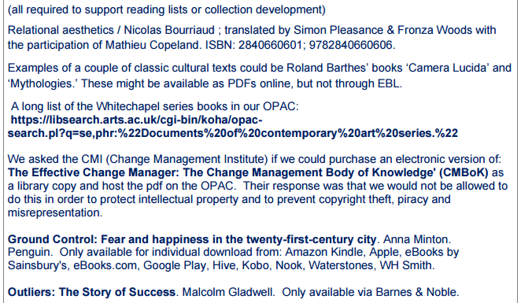
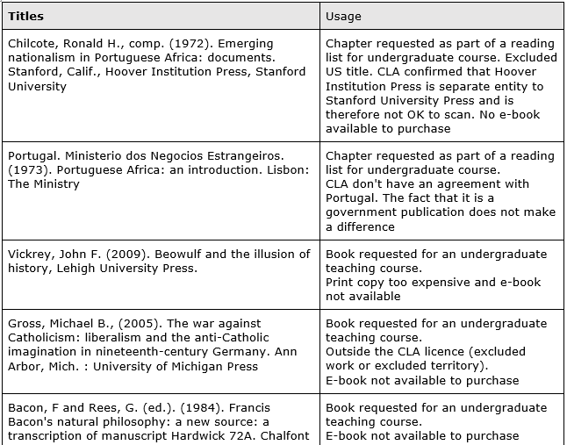
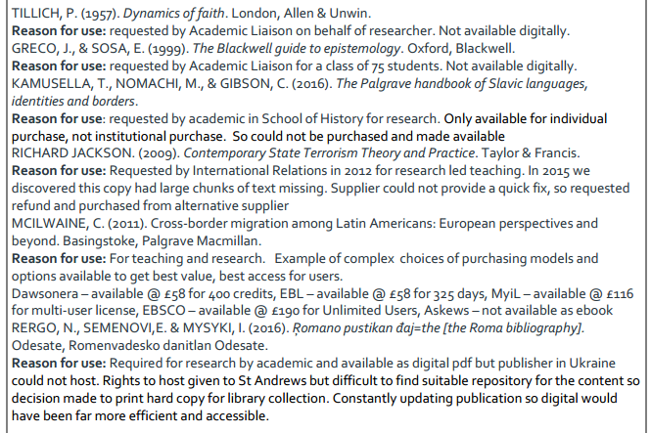
A wish-list of titles (1117 sample)
Notes:
Pilot: Call for proposals and request for sample titles, we wanted to ensure a good spread of insts and selected across 5 (internal Jisc) categories, eg research intensive, t+l, specialised etc… Pilot lasted Jan-Jul 2016 and we accumulated a list of 1200+ titles that libraries wanted digital access to but for whatever reasons couldn’t get it: link to blog for list of libraries
Definition of “monograph” got expanded into “academic book”, to include edited scholarly collections. The main aim was to try and sift out what would be considered “textbooks” as this category was tackled by others in Jisc also was likely to have a more specific set of problems and solutions associated with them. Quote definition form CfP?

Slide 16
What we found out
Work in progress: data is still being tided-up, uniformised and triangulated with Nielsen database, more difficult than it sounds
This is just a sample so will have a degree of bias, but we are looking for patterns
Especially publishers’ names are likely to be different following mergers

Slide 17
Availability problems by titles (1117 sample)
Majority of titles are Print-only
A good proportion of e-books are still “unavailable” to libraries even if an e version exists (reasons eg: non available in UK, no inst licence or unsuitable to needs, too expensive; not on right platform)
Most titles seem to fall within arts & humanities and social sciences, but no “scientific” analysis done
Notes:
Problems with titles available as e- but:
No institutional licence
Not available in the UK
Only available in a package
Too expensive singly
Licence type unsuitable for needs
Only available on a platform they don’t use

Slide 18
Titles by date of publication (1117 sample)
Majority of in-demand titles were published from the 1980s onward
No interest in Public Domain books

Slide 19
Top 10 publishers (1117 sample)
20.4% of titles (228) are Print-only/out of commerce
Publishers and titles distribution by category will change as some publishers have merged with others, we’re checking this
Long tail

Slide 20
Libraries’ requirements

Slide 21
Requirements that a solution should satisfy
Ability to “aggregate” problem titles from libraries’ reading lists
Check reliability of bibliographic data (publishers, ISBNs..) from libraries against authority source (eg Nielsen database?)
Identify copyright owners and obtain licencing permissions
Cater for a “long tail” pattern of requests from libraries
Deliver a timely service for digital copies within short time (few weeks)
Digital copy cost should not be more than a print copy, if available, max £100
On demand service (eg digitisation/provision of digital copy) seemed most appropriate route for ad hoc requests, through existing mechanisms eg BL
Appropriate format: searchable pdf as minimum but epub or HTML5 preferred. Accessibility for users with disabilities a big problem, eg screen readers etc

Slide 22
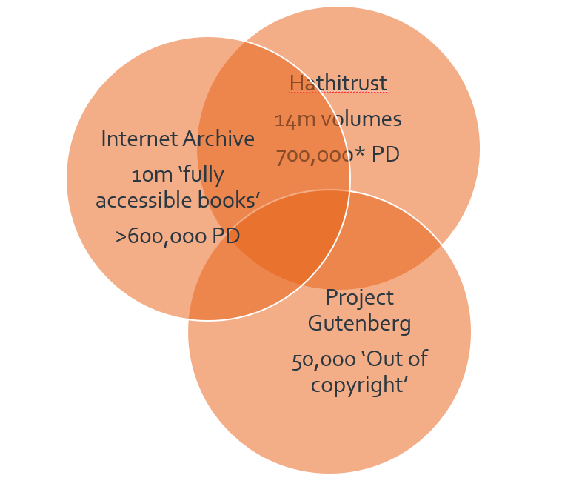
Mapping publicly available digitised books
[Just started]
Related project evaluating sources of digitised openly available books with the aim to link NBK records to existing digitised copies
Starting with major sources (Hathi, IA, Project Gutenberg) and moving on to others (eg Europeana, DPLA…)
Key challenge in identifying books: different terminology used to express licences (PD, CC, Not in copyright…)
Other issues to consider will be:
Overlap/de-duplication?
Trust and persistent URLs
APIs
Of course part of a solution already exists through WorldCat>Hathi Trust relationship
Notes:
Internet Archive: over 600,000 PD books, but likely more, difficulty is identifying books and terminology used for the licences, eg Project Gutemberg books in IA the rights are described as “not in copyright” as opposed to PD
HathiTrust: has 14 million volumes but restricts access to public domain books outside the USA to pre-1876 volumes. This amounts to approximately 700,000 titles

Slide 23
Next steps
Digital access pilots
final report and analysis of data will provide us with a good indication of the state and size of “the problem”
phase 2: approach top ten publishers to explore the issues and see what the response is. Then plan next phase accordingly.
NBK
carry out dialogue with potential suppliers over the Summer, formal procurement in progress, supplier selection in Oct 2016
clarify relationship between NBK and increasing access to digital books (e.g. availability data, licensing, workflow…)
Notes:
Next step: with regard to the digital access pilots, we will have to approach this work in a phased way. What we are about to conclude is phase 1. Next phase will be

Slide 24
Image credits
Coin by Kirill Tomilov from the Noun Project CC https://thenounproject.com/search/?q=coin+two+sides&i=160453question mark Help
Help (question mark) By Consumer Financial Protection Bureau, US from the Noun Project Public domain https://thenounproject.com/search/?q=question+mark&i=89611
Work in progress by Gleb Khorunzhiy from the Noun Project CC https://thenounproject.com/search/?q=works+in+progress&i=215094
Alert by Alain LOUBET from the Noun Project CC https://thenounproject.com/search/?q=health+warning&i=14055

Slide 25
Thank you
Any questions?
Neil Grindley, neil.grindley@jisc.ac.uk @neilgrindley
Paola Marchionni, paola.Marchionni@jisc.ac.uk @paolamarchionni

